Slide 1
Respiratory and Ventilatory failure and positive pressure
Chris MacAllister

Slide 2
Learning Objectives
Describe the concept, underlying pathophysiology, impairments and clinical presentations of type 1 and 11 respiratory failure
Justify an evidence-based treatment plan for the management of a patient with type 1 and type 2 respiratory failure
Describe and explain the physiology and relevant precautions and contraindications for using continuous positive airway pressure (CPAP), Non-invasive positive pressure ventilation, MI:E and intermittent positive pressure breathing ( IPPB)

Slide 3
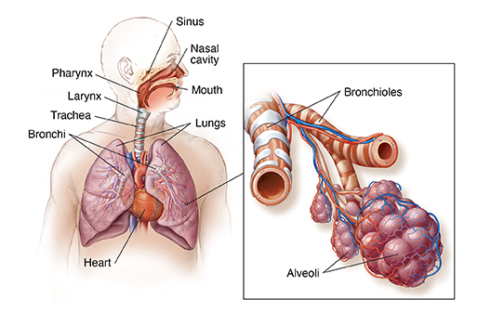
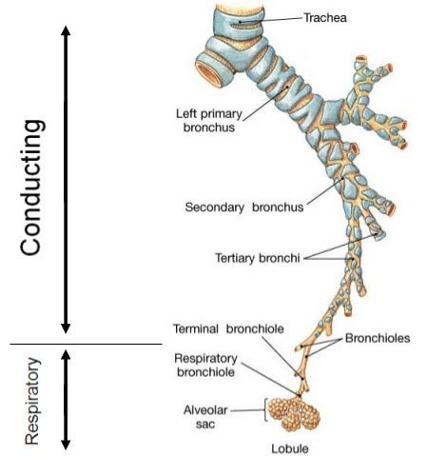
Inspiration and Expiration

Slide 4
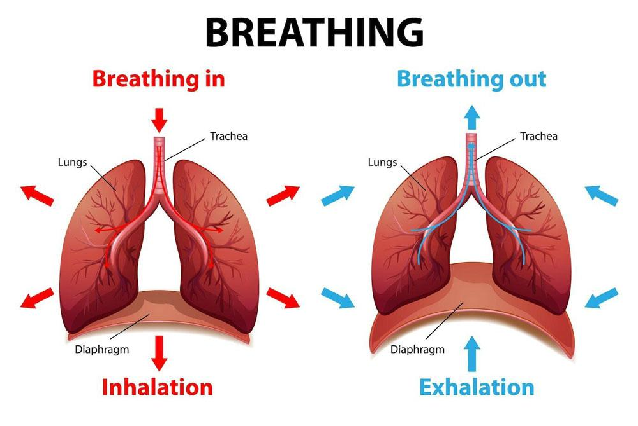
Inspiration and Expiration
Notes:
Boyles law – as volume INCREASES, pressure DECREASES (inversely proportional)
Inspiration -> diaphragm contracts -> INCREASE in lung volume
Flow of air + increase in volume = REDCUED pressure
REDUCED Pressure = disequilibrium between room + lung air pressure = air fills lungs to equalise that pressure = inspiration
VV for expiration

Slide 5
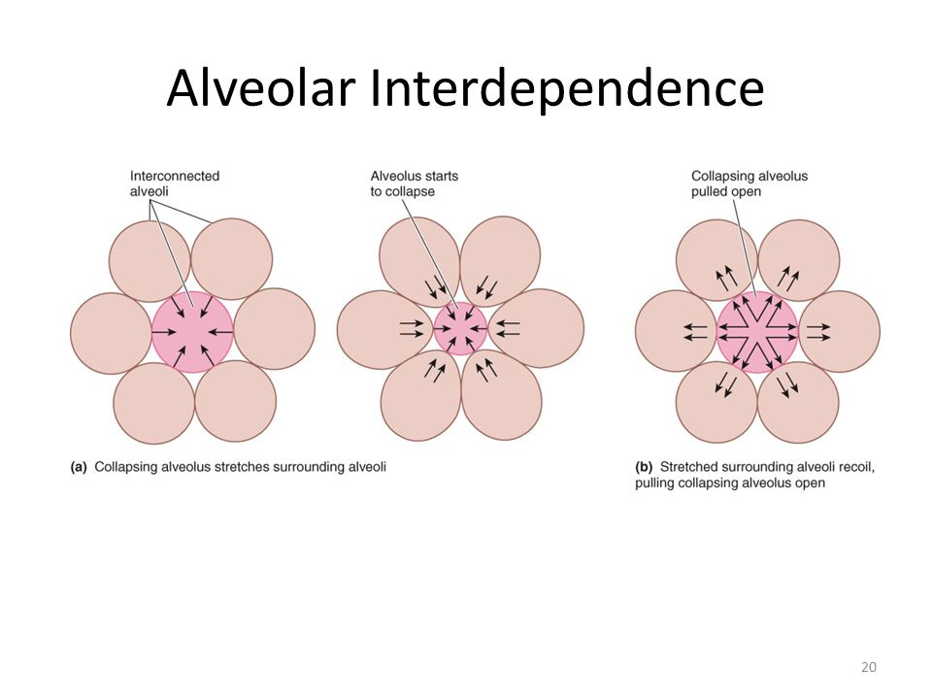
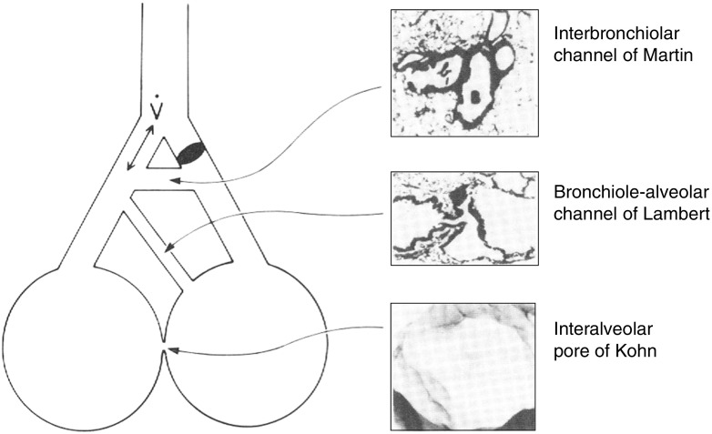
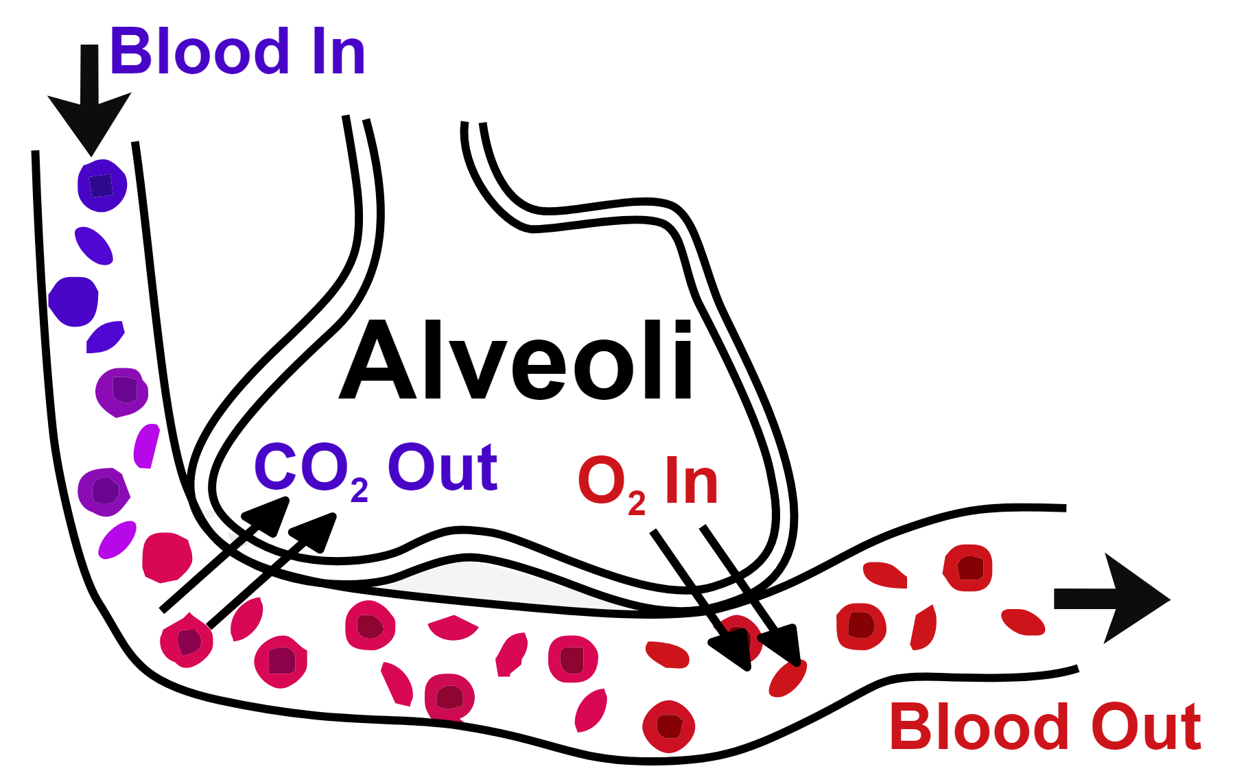
The alveoli anatomy and special features

Slide 6
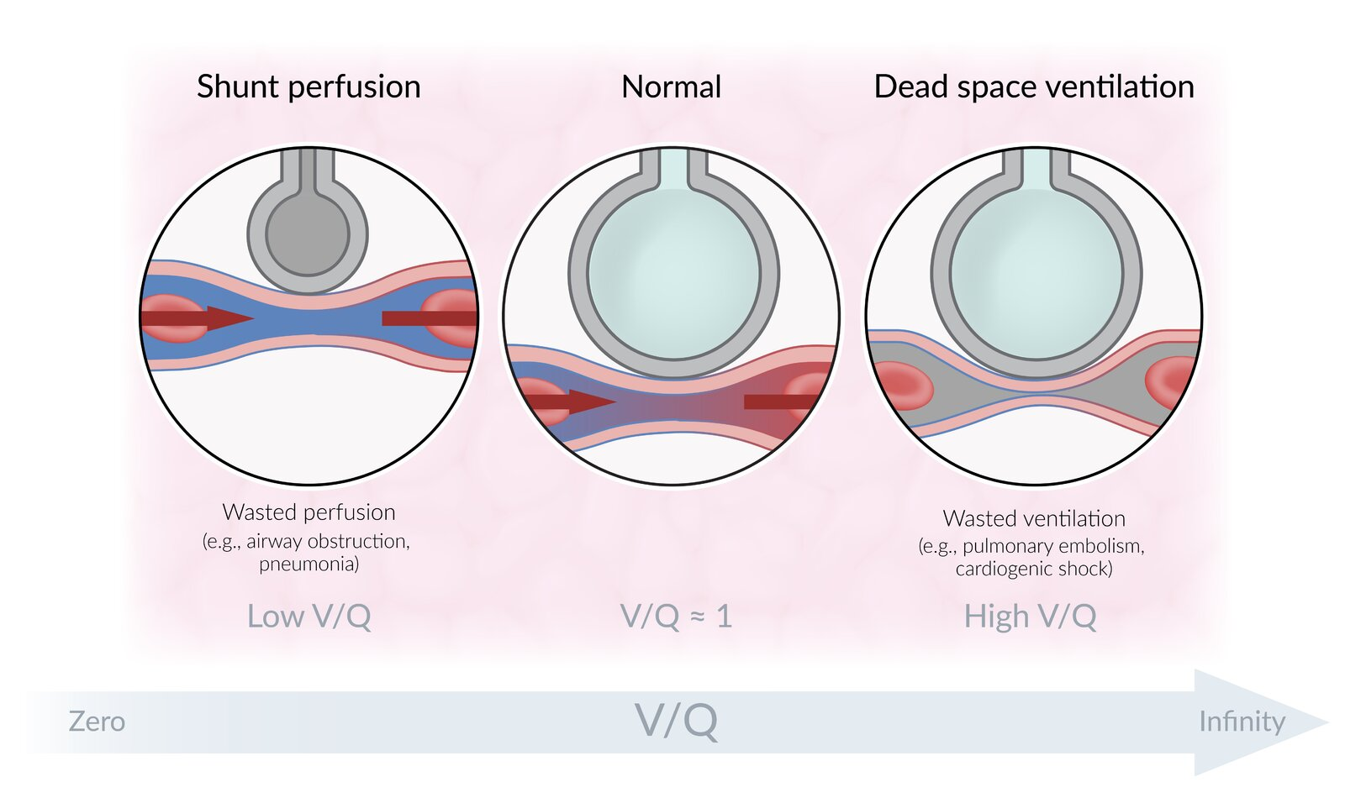
V/Q Mismatch
Physiological Dead space (High V/Q)
Shunt (Low V/Q)

Slide 7
V/Q Mismatch
Shunt
Low V/Q
Air not enter alveoli to allow gas exchange
Poorly oxygenated blood
Dead space
High V/Q
Air getting in but poor perfusion

Slide 8
Type 1 respiratory failure
PaO2 <8kPa with a normal or Low PaCO2 ( <4 )
Hypoxia (Low O2 in tissue)
Associated with disease process that directly affects the alveoli:
  Pneumonia
  Pulmonary Odeama
  Adult respiratory distress syndrome (ARDS) etc ….

Slide 9
Type 2 respiratory failure
PaCO2 >6kPa +/- PaO2 <8kpa
Hypercapnic (high blood CO2)
Failure of alveolar ventilation
Commonly associated with COPD
Can also be associated with :
  Reduced respiratory drive
  Airway impairment
  Neuromuscular conditions
  Chest wall deformity
  Exhaustion associated with prolonged hypoxia

Slide 10
Signs of Hypoxia and Hypercapnia
Hypoxia:
  Signs of respiratory distress
  Altered mental status
  Tachypnoea (rapid breathing)
  Bradycardia / Tachycardia
  Restlessness
Hypercapnia :
  Signs of respiratory distress
  Confusion
  Pounding headache
  Tachycardia
  Breathlessness and Tachypnoea
  Drowsiness or reduced GCS
  Flushed face and extremities
  CO2 flap

Slide 11
Common causes of respiratory failure
Loss of respiratory drive | CVA / brain injury Metabolic encephalopathy Effects of drugs
Neuropathy and neuromuscular disease | Spinal cord injury Phrenic nerve injury Guillan-barre syndrome Myasthenia gravis
Chest wall abnormality | Trauma Scoliosis
Airway obstruction | Foreign body Tumour Infection Sleep apnoea
Lung pathology | Asthma Pneumonia COPD Acute and chronic fibrosing ARDS

Slide 12
Management of respiratory failure
Try to treat the underlying condition eg:
  Wheeze : bronchodilation
  Retained secretions : airway clearance to clear secretions and allow re-expansion
  Antibiotics for pneumonia
  Diuretics to increase kidney function and reduce Odeama
  Change delivery or titrate up the fio2 oxygen being delivered to resolve hypoxia
  Hypoxia should ALWAYS be a primary concern and should be corrected
  If standard interventions do not work we need to consider using positive pressure to improve oxygenation and/ or ventilation

Slide 13
Positive pressure therapies
Oxygenation/ ventilation strategies:
  CPAP : continuous positive airway pressure
  BIPAP / NIV : Biphasic positive airway pressure / Non-invasive ventilation
Airway Clearance strategies
  MI:E : cough assist
  IPPB : ( Bird) intermittent positive pressure breathing

Slide 14
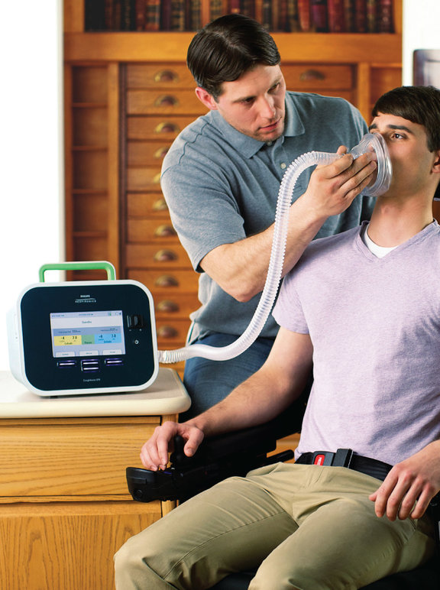
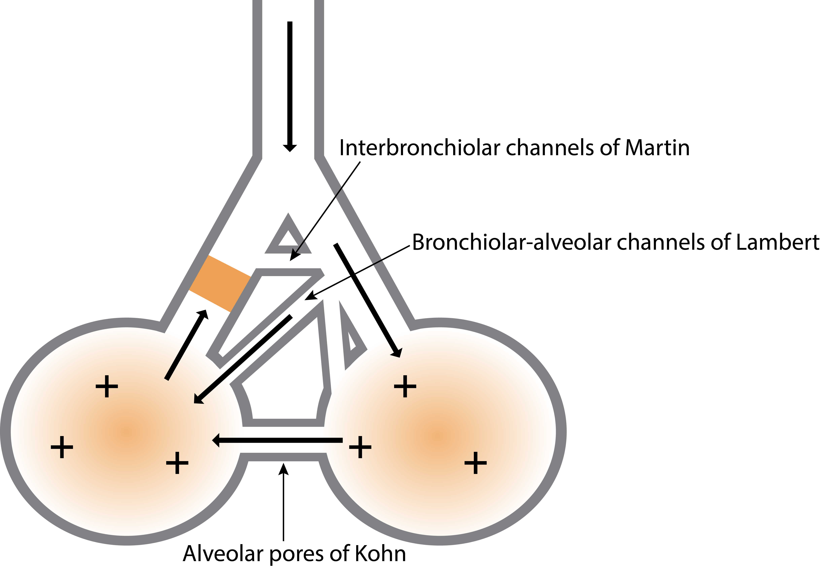
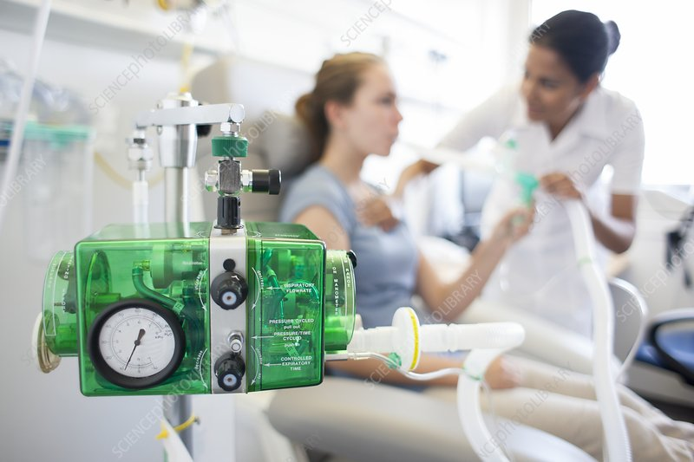
Positive pressure airway clearance : the effects
Aids Airway Clearance by :
Improves VT
Reduced WOB
Increases use of collateral channels and interdepence of the alveoli
Strengthens and augments the expiratory flow during a cough (cough assist)
Great for patients who :
Are in pain
Are struggling to take a deep breath
Have thick secretions that aren't cleared with other technqiues
Patients with a weak cough : after surgery or due to neuro complications

Slide 15
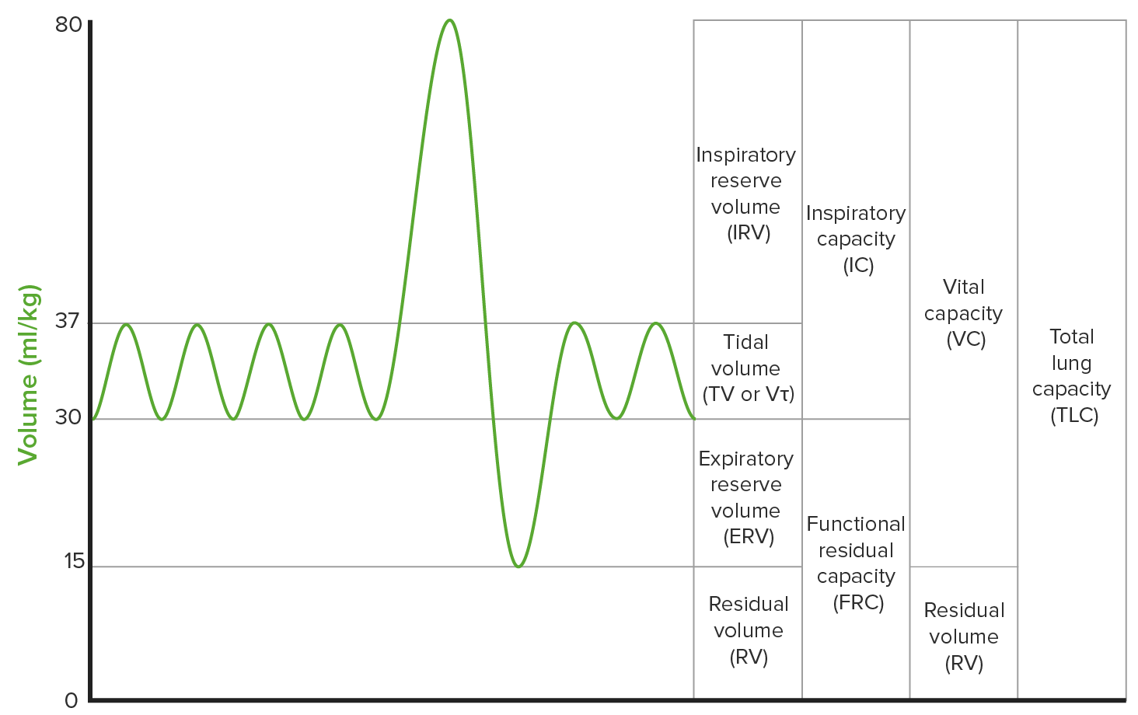
Positive pressure ventilation : the effects
Decreases work of breathing
  Off loads the accessory mm
Improves lung mechanics
  Improves FRC
  Recruits collapsed lung
  Increases alveolar ventilation
  Improves V/Q mismatching
  Increases SA for gas exchange
  Reduced intrapulmonary shunt
  Enhances pulmonary compliance

Slide 16
Contraindications
Absolute contraindications :
  Undrained acute pneumothorax
  Severe facial deformity
  Facial burns / trauma
  Fixed upper airway surgery /trauma
  Frank haemoptysis
  Ruptured Oesophagus
  Frequent Vomiting
Relative contraindications:
  Bronchopleural fistula
  Recent bronchial or oesophageal surgery
  Patient intolerance
  Raised ICP
  Bullous or cystic / cavitating lung disease

Slide 17
CPAP
What is it ?
  Continuous positive airway pressure
  CPAP delivers PEEP and maintains the set pressure throughout the respiratory cycle through both inspiration and expiration
  Provides the patient with positive end expiratory pressure (PEEP):
    Measured in cmH2O
    Breathing out against resistance creates back pressure and splints open the airways

Slide 18
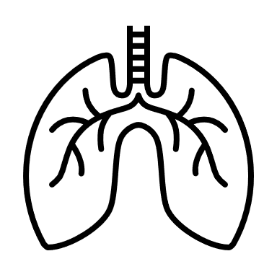


Indications for CPAP
Acute Type 1 respiratory failure
Left ventricular failure with pulmonary odeama
Increased work of breathing
Decreased FRC/ Atelectasis
Weaning from mechanical ventilation
Obstructive sleep apnoea ( OSA)

Slide 19
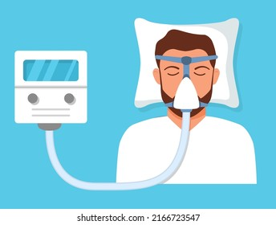
CPAP effects
Advantages to PEEP:
  Splints open the airways
  Increases FRC
  Recruits alveoli and prevents collapse on expiration
  Improves V/Q mismatch
  Greater surface area for gas exchange
  Improves collateral ventilation
Disadvantages to PEEP:
  Reduced venous return to heart
  Reduced Cardiac output and therefore Blood pressure
  DOES NOT IMPROVE VENTILATION
Can be used in T1RF to improve hypoxia associated with alveolar collapse and congestion

Slide 20
NIV or BIpap
What is it ?
  Known as both non-invasive ventilation and biphasic positive airway pressure
  Has an inspiratory phase and an expiratory phase
  IPAP and EPAP or Pressure support and PEEP
How does it work ?
  A high flow of gas is delivered into the airway via a tight-fitting mask creating positive pressure
  The device alternates between high inspiratory pressure and a lower expiratory pressure
  The higher inspiratory pressure augments the patient’s own inspiratory effort, the lower expiratory pressure creates PEEP.

Slide 21
Indications for NIV
Any patient with un-resolving respiratory acidosis pH<7.35
To prevent intubation in acute respiratory failure
Exacerbation of COPD with persistent acidosis pH <7.35

Slide 22
NIV / BIPAP
Aids alveolar ventilation
  Increases tidal volume
  Increases the clearance of CO2
  Improved gas exchange
Reduced work of breathing
  Prevents respiratory muscle fatigue
  Decreases Resp rate
PEEP/ EPAP splints open the airways and helps to prevent collapse on expiration

Slide 23
Adverse effects of positive pressure therapy
Pressure injuries from the mask :
  Prolonged use
  Poor fitting mask
Abdominal distension :
  Poor synchronisation with mask
  Patients not tolerating settings
Barotrauma
  Always a risk with positive pressure

Slide 24
Relative contra-indications to NIV
Ph < 7.15 + additional signs of deterioration
Haemodynamic instability
GCS <8
Confusion / Agitation
Small bowel obstruction or marked abdominal distention
Copius secretions
Severe co-morbidities
Need for ongoing sedation

Slide 25
Commencement of NIV
Each trust will have a unique set of guidelines to support safe commencement of NIV
In an acute scenario you will likely be setting patients up using a ventilator or an acute NIV machine for a longer term patient who has their own machine you will use a different macchine.
Essentially the main difference:
  Acute machines : Pressure support and PEEP
  Long term machines : IPAP and EPAP

Slide 26
Commencement of NIV
Pressure Support starting around 10 or an appropriate level to achieve target VT
  Wait 10/20 mins
  Complete ABG
  Titrate PS and PEEP appropriately
  Monitor for signs of deterioration
IPAP and EPAP starting pressures are outlined in the BTS guidelines....

Slide 27
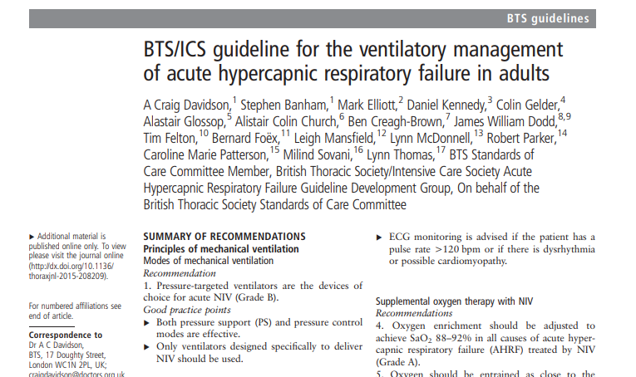
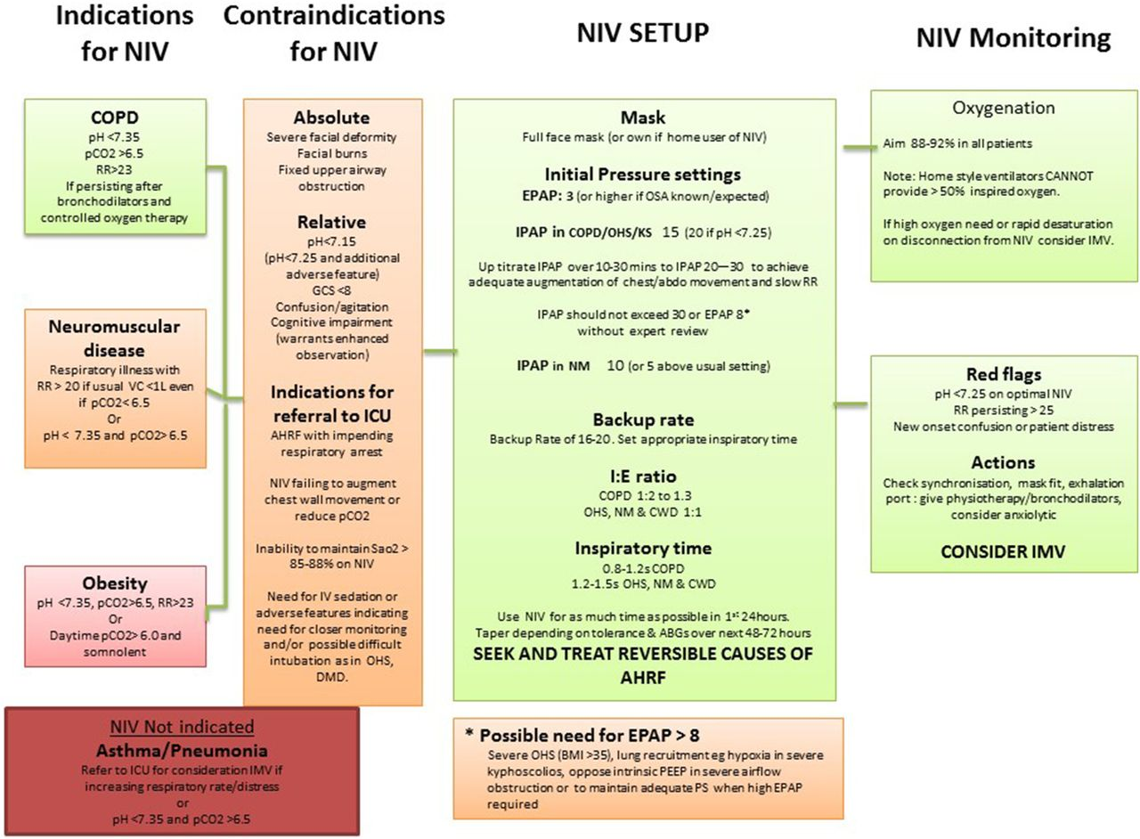
BTS guidelines

Slide 28
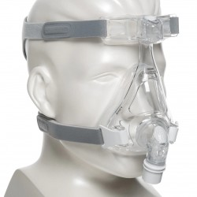
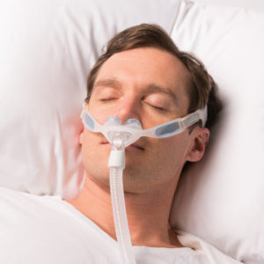
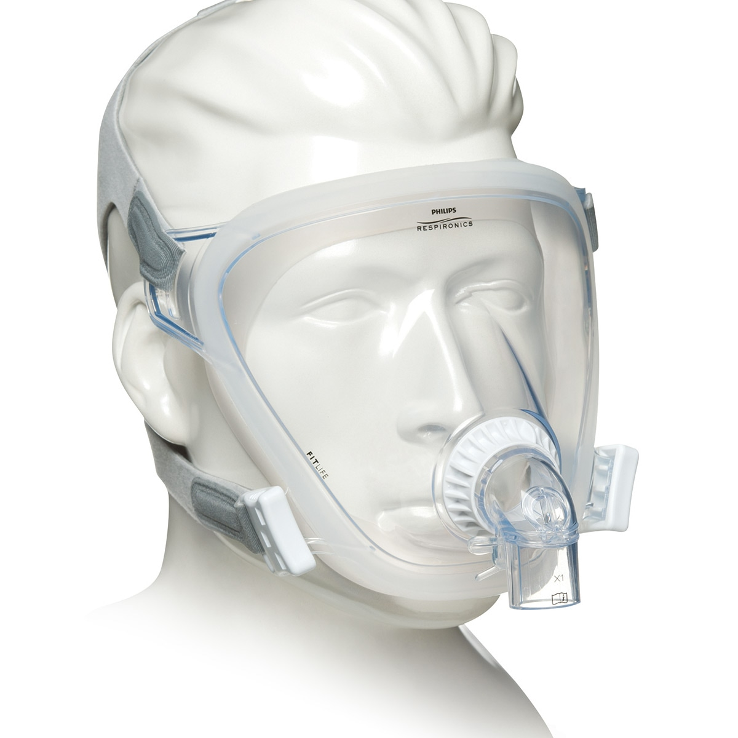
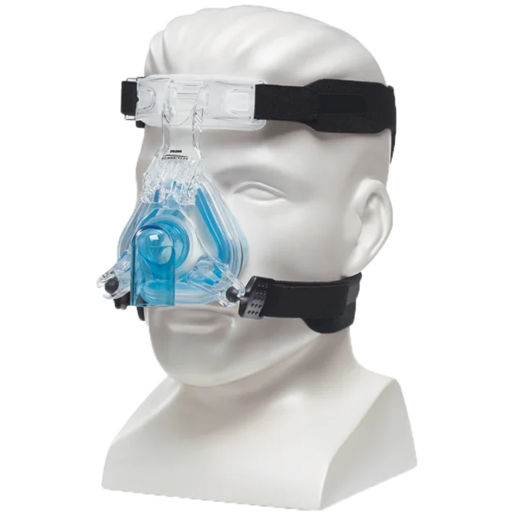
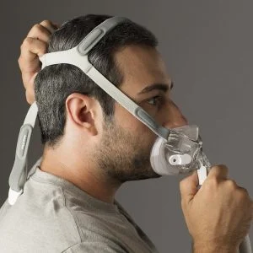
Interfaces

Slide 29
Signs of deterioration
Worsening ABG despite CPAP or NIV
Persistent RR > 30l/min
New onset confusion, agitation or restlessness
Reduced GCS
Increased respiratory effort

Slide 30
Chronic use of Positive pressure
Pathologies that affect the respiratory mechanics or compliance of the lungs :
  Degenerative neuro-muscular disease
  Obstructive sleep apneoa
  End stage lung disease

Slide 31
Neuro-muscular disease
  Neuro-muscular disease :
    "Progressive muscular impariment leading to loss of ambulation, being wheel-chair bound, swallowing difficulties, respiratory mm weakness "
    Eg motor neuron disease, myesthentia gravis, myotonic dystrophy etc
  Affects the respiratory pump muscles
    Lose ability to clear Co2 due to reduced ability to generate appropriate Vt
    Lose bulbar and glottal function and therefore ability to generate cough
  NIV in this pateint group has been shown to increase quality of life and survival
  Cough assist someevidence to support MI:E, further evidence needed to specifically guide clinical practice

Slide 32
Obstructive sleep apneoa
  Obstructive sleep apneoa :
    During sleep due to neurological defect or obesity the airway becomes obstructed
    Diagnosed through sleep studies conducted as an inpatient
      Look at saturations, heart rate and blood pressure overnight
      Complete early morning blood gas
  CPAP and NIV has been shown to be an effective way to manage OSA, reduce the number of wakeful periods during the night and stabilisation of ABGs

Slide 33
COPD end stage and acute
  End stage COPD and acute exacerbations:
    Emphesematous or inflammatory changes to the lungs result in reduced surface area for gas exchange
    Reduced elasticity of the lungs
    Reduced elasticity of airways
    NIV needed to blow off Co2 and splint open the airways
  Shown to improve chronic hypercapnic COPD patients' mortality

Slide 34
Case study
70 year old day 4 post tAVR
PMH : Rheumatic disease, COPD, smoker. In +++ pain and struggling to clear chest, Nurses report very thick brown secretions, but pt is not able to clear easily.
A: own, patent
B: SV cold humidified O2 35% RR 20
AUSC: reduced ae into bases + coarse crackles in mid zones and bases
ABG : PH 7.35 PaCo2 6.00 PO2 10.00 HCo3 23.0 BE 3.0
C: Hr 78 BP 110/89 T 37.5
D: 15/15
E: catheter, CVC, arterial line, monitoring
  Sitting upright in bed, not able to talk in full sentances, wheeze and crackle on expiration
What type of resp failure ?
Problem list ?
Treatment plan ?
WHY ?

Slide 35
Let'd do some case studies..
40 year old female.
Day 3 post CABG, slowly been deteriorating over the last 2 days
Asked to see on the ward :
A: own, patent
B: SV High flow oxygen 50% 50L RR 30
AUSC: Reduced air entry into bases
ABG : Ph 7.35 PCo2 5.00 PaO2 7.00 HCo3 23.0 BE 1.0
C: Hr 120 BP 110/80 T 37.0 // noradrenaline 0.05
D: 15/15
E: Catheter, 2 x drains insitu, CVC, arterial line
  Pt sitting in bed, pale and sweaty, use of accessory mm, pursed lip breathing, blue tinge to lips
What type of resp failure ?
Problem list ?
Treatment plan ?
WHY ?

Slide 36
Case study
80 year old new admission after a fall with community acquired pneumonia. PMH : T2DM, COPD
New confusion on the ward, earlier in the day was complaining of a crushing headache
A: own, patent
B: SV NC 3l Spo2 88% Rr 23
AUSC: coarse crackles t.o
ABG : PH 7.30 PaCO2 8.00 PaO2 8.00 HCO3 27.0 BE 0.3
C: Hr 70 BP 120/80 T 39.0
D: 14/15 new onset confusion
E: Catheter, cannula in arm, monitoring
  Slumped in bed, flushed, hands shaking and flapping
What type of resp failure ?
Problem list ?
Treatment plan ?
WHY ?

Slide 37
References
Ambrosino, N., et al. “Chronic Respiratory Care for Neuromuscular Diseases in Adults.” European Respiratory Journal, vol. 34, no. 2, 1 Aug. 2009, pp. 444–451, erj.ersjournals.com/content/34/2/444, https://doi.org/10.1183/09031936.00182208.
Chatwin, Michelle, et al. “Airway Clearance Techniques in Neuromuscular Disorders: A State of the Art Review.” Respiratory Medicine, vol. 136, Mar. 2018, pp. 98–110, www.sciencedirect.com/science/article/pii/S0954611118300209, https://doi.org/10.1016/j.rmed.2018.01.012.
Davidson, Craig, et al. “British Thoracic Society/Intensive Care Society Guideline for the Ventilatory Management of Acute Hypercapnic Respiratory Failure in Adults.” BMJ Open Respiratory Research, vol. 3, no. 1, Mar. 2016, p. e000133, https://doi.org/10.1136/bmjresp-2016-000133.
Liao, Hao, et al. “Efficacy of Long-Term Noninvasive Positive Pressure Ventilation in Stable Hypercapnic COPD Patients with Respiratory Failure: A Meta-Analysis of Randomized Controlled Trials.” International Journal of Chronic Obstructive Pulmonary Disease, vol. Volume 12, Oct. 2017, pp. 2977–2985, https://doi.org/10.2147/copd.s148422. Accessed 12 Apr. 2020.
Morrow, Brenda, et al. “Cough Augmentation Techniques for People with Chronic Neuromuscular Disorders.” Cochrane Database of Systematic Reviews, 22 Apr. 2021, https://doi.org/10.1002/14651858.cd013170.pub2.
“NIV | British Thoracic Society | Better Lung Health for All.” Www.brit-Thoracic.org.uk, www.brit-thoracic.org.uk/quality-improvement/guidelines/niv/.
Pinto, Venessa, and Sandeep Sharma. “Continuous Positive Airway Pressure (CPAP).” PubMed, StatPearls Publishing, 2020, www.ncbi.nlm.nih.gov/books/NBK482178/.
Potchileev, Iordan, et al. “Positive Pressure Ventilation.” PubMed, StatPearls Publishing, 2021, www.ncbi.nlm.nih.gov/books/NBK560916/.
Spicuzza, Lucia, et al. “Obstructive Sleep Apnoea Syndrome and Its Management.” Therapeutic Advances in Chronic Disease, vol. 6, no. 5, 9 July 2015, pp. 273–285, www.ncbi.nlm.nih.gov/pmc/articles/PMC4549693/, https://doi.org/10.1177/2040622315590318.

